Slide 1

Travel Expert
Software Project
MMBJ Developers
PRESENTER: John, Megha, Brian and Mahmood
November 21, 2014

Slide 2


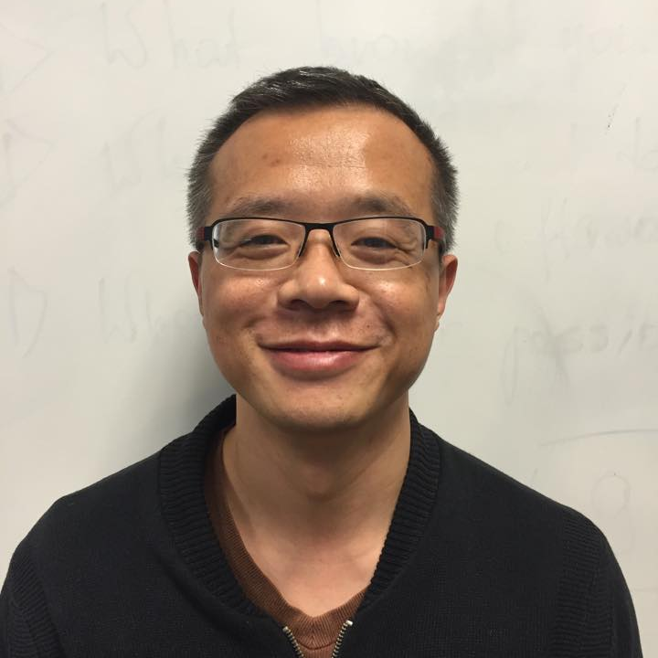
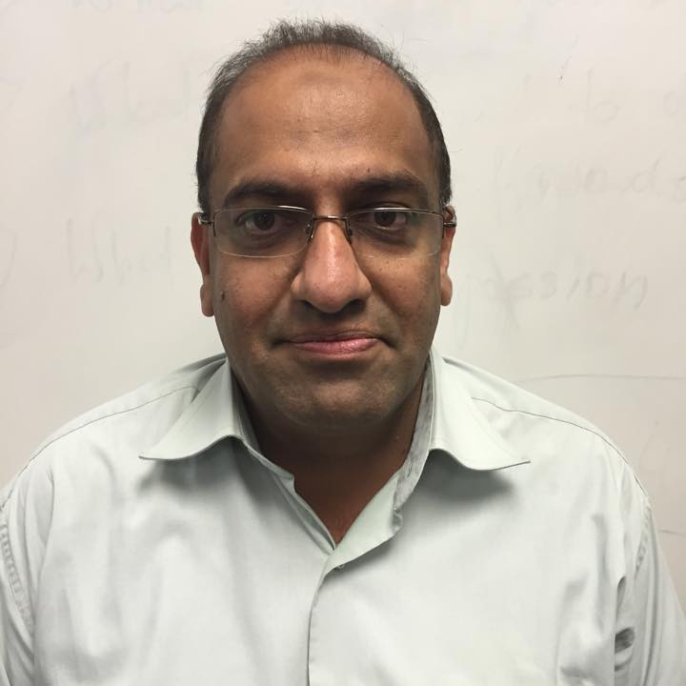
The MMBJ Team
John
Megha
Brian
Mahmood
Team Lead
Software developer
Software developer
Software developer

Slide 3
Goals
To build a user-friendly system and interface
Easy to store information of our customers and agents
Compatible with hardware and software
Quality of expertise
Ability to collect feedback

Slide 4
Objectives
Reducing customer complaints by 80%
Processing several hundred requests from clients at the same time
Improving the efficiency of the package booking function

Slide 5
Assumptions - Contingencies
1
Users technical skills
1
User training / orientation of system
2
Scalability
2
Hosting options
3
System failure
3
OS, Hardware, Power etc.
4
Conflicts / variations
4
Keep hard copies/ maintenance period

Slide 6
Assumption: Users Technical Skills
Contingency Plan: User Training / Orientation of System
Setting training goals
Assessment of end user needs
Software training
Training delivery methods
Group demonstration of system using projector
One to one training / feedback
Training documentation
Hard copies of training material for new employees

Slide 7
Assumption: Scalability
Scalability is the ability of system to handle growth in a capable manner
Contingency Plan:
Hosting options
Self Hosting
Third Party
Hosting with us

Slide 8
Assumptions
Contingencies
System failures
Hardware failure
Software failure
Power failure
Implementing mirroring on hard drive
Using Antivirus software
Daily and weekly backups
Keeping backup copy offsite
Implementing UPS

Slide 9
Assumption: Conflicts / Variations
Contingency Plan:
Keep hard copies for evaluation
Weekly / monthly reviews in meeting
3 months maintenance period
Change in the code
Change in the layout / structure
Change in the reporting system

Slide 10
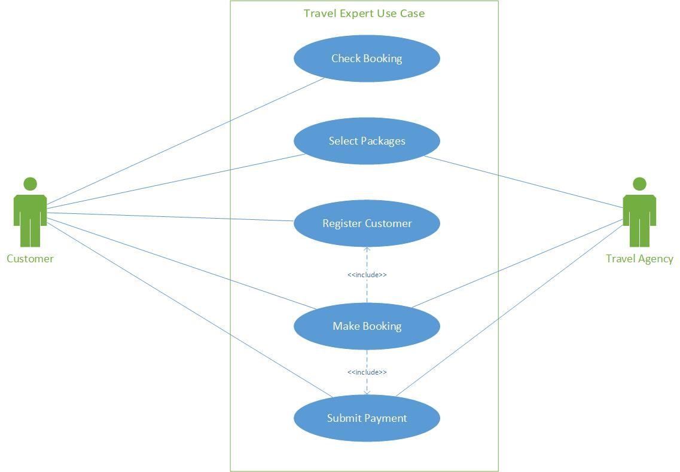
Use Case diagram

Slide 11
Scope definition
Database design
Application development
Web based menu
Web based reports & analytics
Placing order online

Slide 12
LIVE DEMO

Slide 13
Additional Features
Future Implementation
Agent Login
Language translation
Comprehensive packages e.g. car rentals, hotels, bookings, airlines etc.

Slide 14
Questions/Comments !

